Slide 1
Selection Sort Upper Bound
void SelectionSort (int[] data) for (int i = 0; i < data.length; i++)
int smallest = i
for (int j = i+1; j < data.length; j++)
if (data[j] < data[smallest]) smallest = j
swap(data, smallest, i)
Operation | Count | Operation | Count
int i = 0 |  | j < data.length
i < data.length |  | j++
i++ |  | data[j] < data[smallest]
int smallest = i |  | smallest = j
int j = i+1 |  | swap(data, smallest, j)
Operation | Count | Operation | Count
int i = 0 | 1 | j < data.length
i < data.length |  | j++
i++ |  | data[j] < data[smallest]
int smallest = i |  | smallest = j
int j = i+1 |  | swap(data, smallest, j)
Operation | Count | Operation | Count
int i = 0 | 1 | j < data.length
i < data.length | n+1 | j++
i++ |  | data[j] < data[smallest]
int smallest = i |  | smallest = j
int j = i+1 |  | swap(data, smallest, j)
Operation | Count | Operation | Count
int i = 0 | 1 | j < data.length
i < data.length | n+1 | j++
i++ | n | data[j] < data[smallest]
int smallest = i |  | smallest = j
int j = i+1 |  | swap(data, smallest, j)
Operation | Count | Operation | Count
int i = 0 | 1 | j < data.length
i < data.length | n+1 | j++
i++ | n | data[j] < data[smallest]
int smallest = i | n | smallest = j
int j = i+1 |  | swap(data, smallest, j)
Operation | Count | Operation | Count
int i = 0 | 1 | j < data.length
i < data.length | n+1 | j++
i++ | n | data[j] < data[smallest]
int smallest = i | n | smallest = j
int j = i+1 | n | swap(data, smallest, j)
Operation | Count | Operation | Count
int i = 0 | 1 | j < data.length | 1 + 2 + 3 + … + n
i < data.length | n+1 | j++
i++ | n | data[j] < data[smallest]
int smallest = i | n | smallest = j
int j = i+1 | n | swap(data, smallest, j)
Operation | Count | Operation | Count
int i = 0 | 1 | j < data.length | 1 + 2 + 3 + … + n
i < data.length | n+1 | j++ | 0 + 1 + 2 + … + (n-1)
i++ | n | data[j] < data[smallest]
int smallest = i | n | smallest = j
int j = i+1 | n | swap(data, smallest, j)
Operation | Count | Operation | Count
int i = 0 | 1 | j < data.length | 1 + 2 + 3 + … + n
i < data.length | n+1 | j++ | 0 + 1 + 2 + … + (n-1)
i++ | n | data[j] < data[smallest] | 0 + 1 + 2 + … + (n-1)
int smallest = i | n | smallest = j
int j = i+1 | n | swap(data, smallest, j)
Operation | Count | Operation | Count
int i = 0 | 1 | j < data.length | 1 + 2 + 3 + … + n
i < data.length | n+1 | j++ | 0 + 1 + 2 + … + (n-1)
i++ | n | data[j] < data[smallest] | 0 + 1 + 2 + … + (n-1)
int smallest = i | n | smallest = j | 0 + 1 + 2 + … + (n-1)
int j = i+1 | n | swap(data, smallest, j)
Operation | Count | Operation | Count
int i = 0 | 1 | j < data.length | 1 + 2 + 3 + … + n
i < data.length | n+1 | j++ | 0 + 1 + 2 + … + (n-1)
i++ | n | data[j] < data[smallest] | 0 + 1 + 2 + … + (n-1)
int smallest = i | n | smallest = j | 0 + 1 + 2 + … + (n-1)
int j = i+1 | n | swap(data, smallest, j) | n

Slide 2
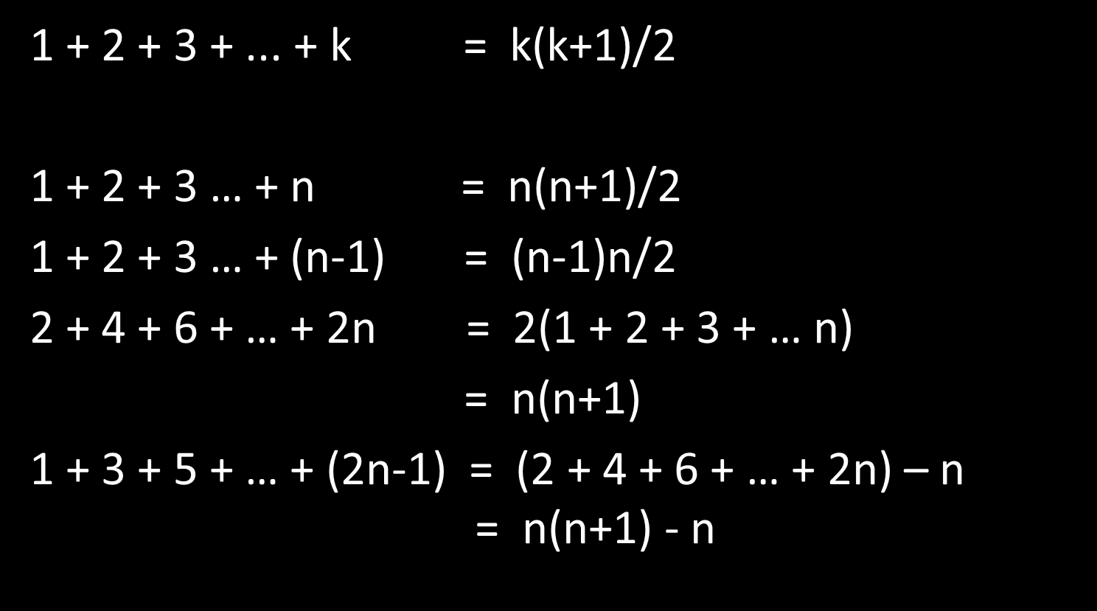
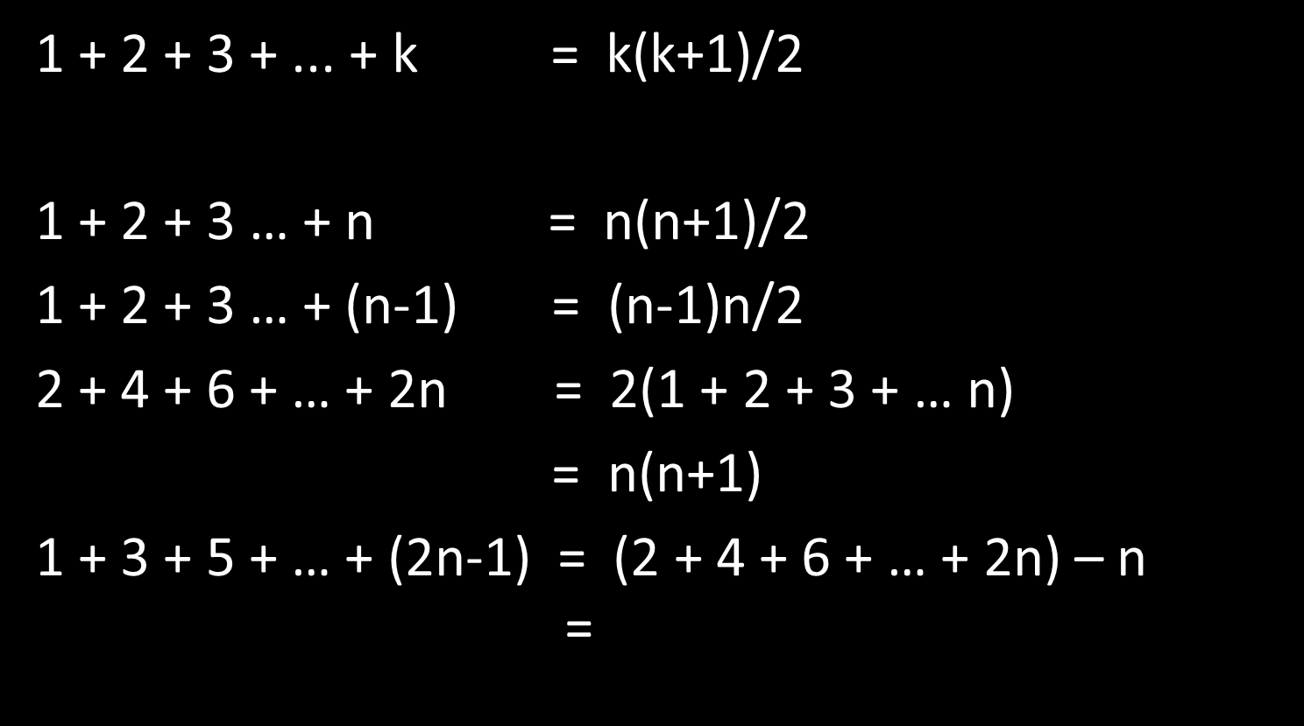
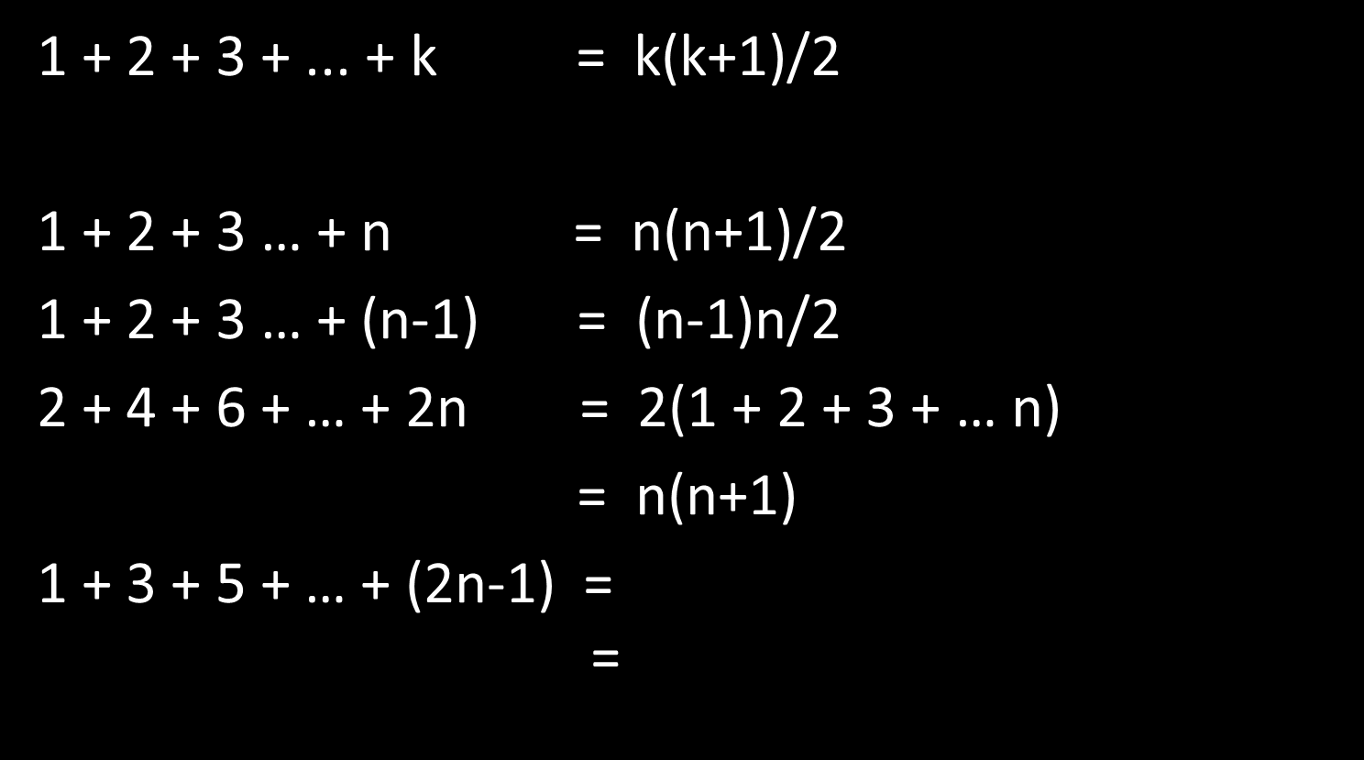
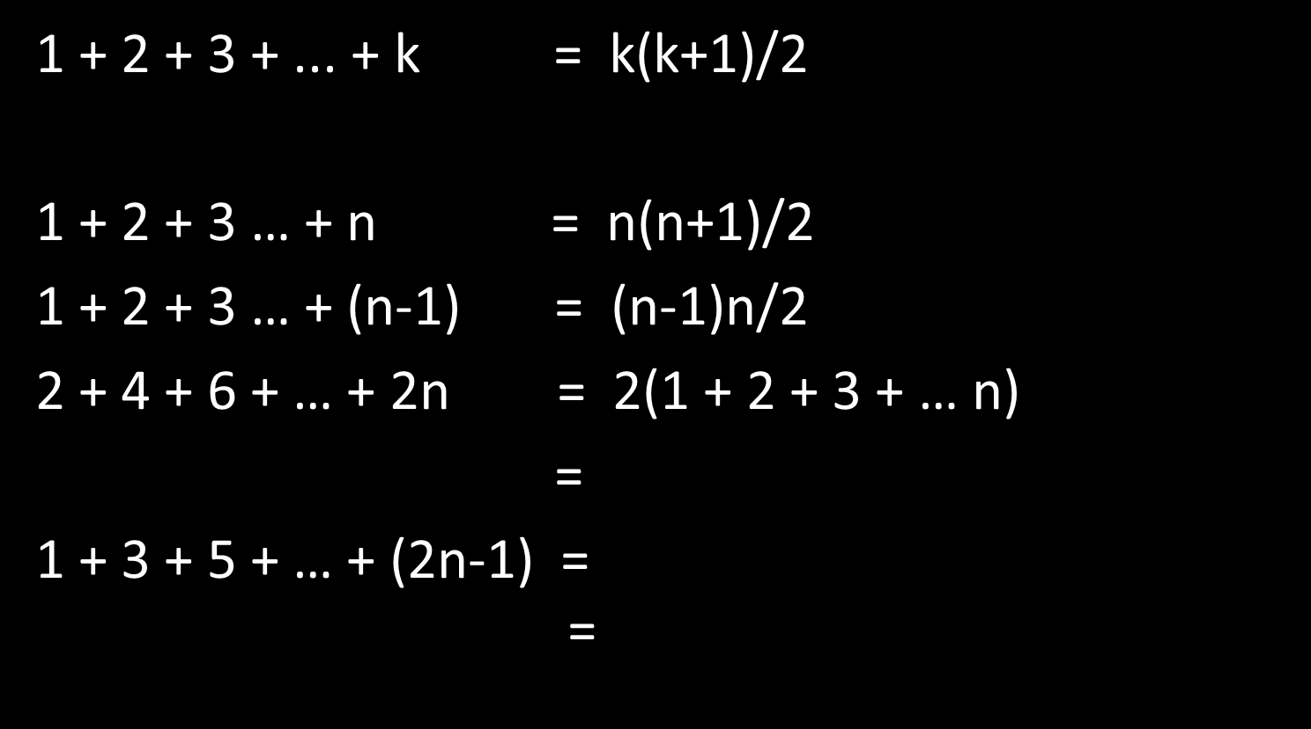
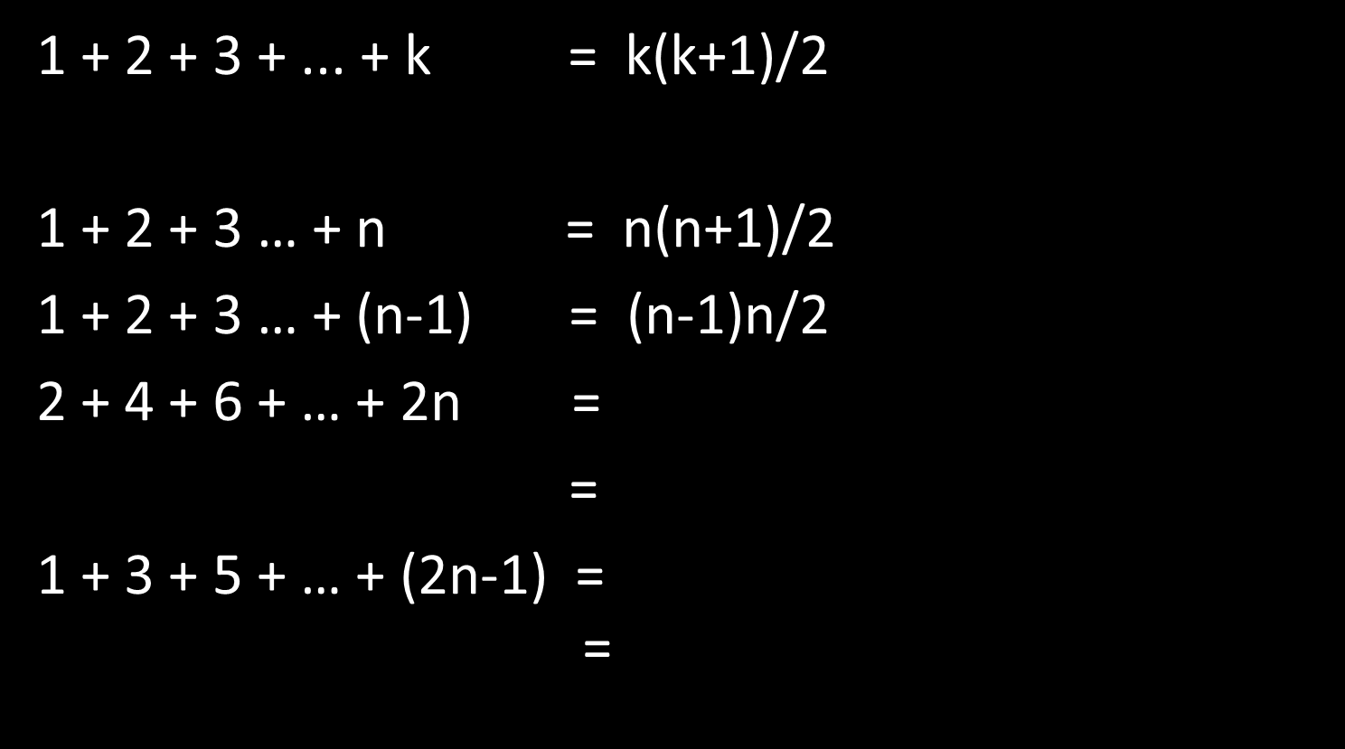
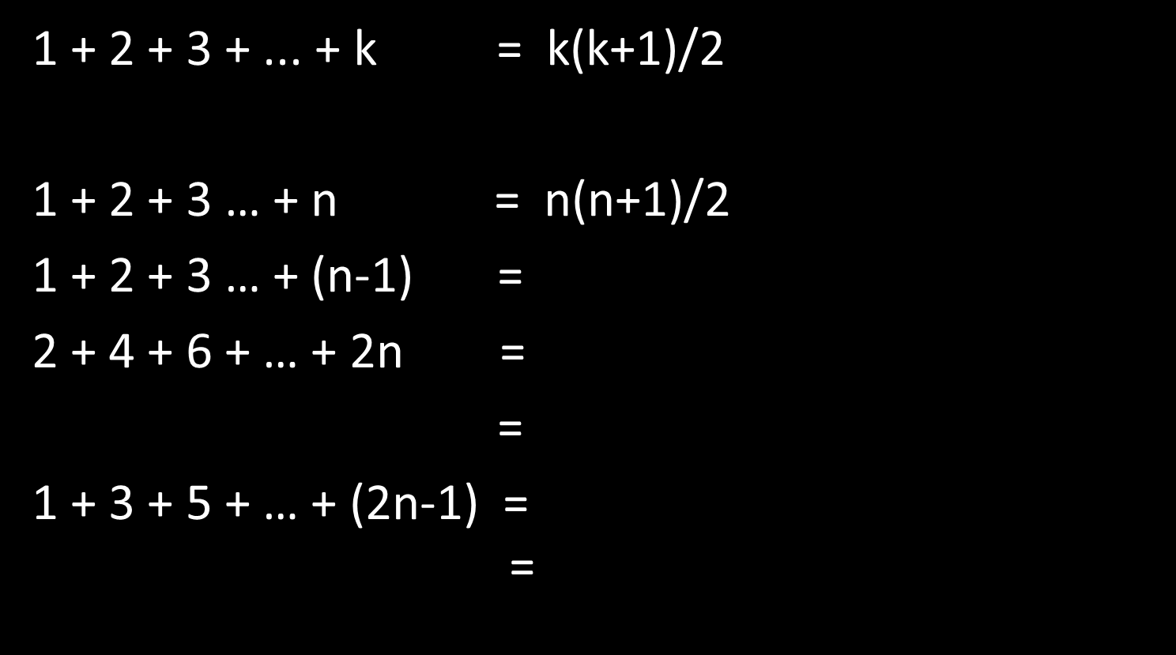
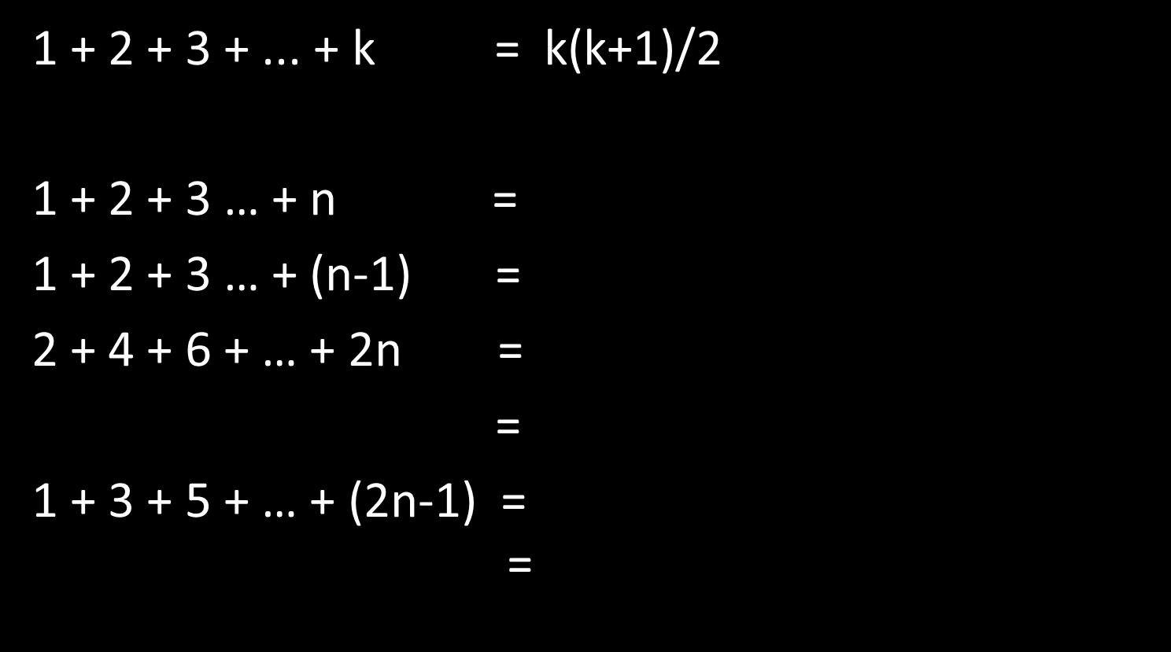
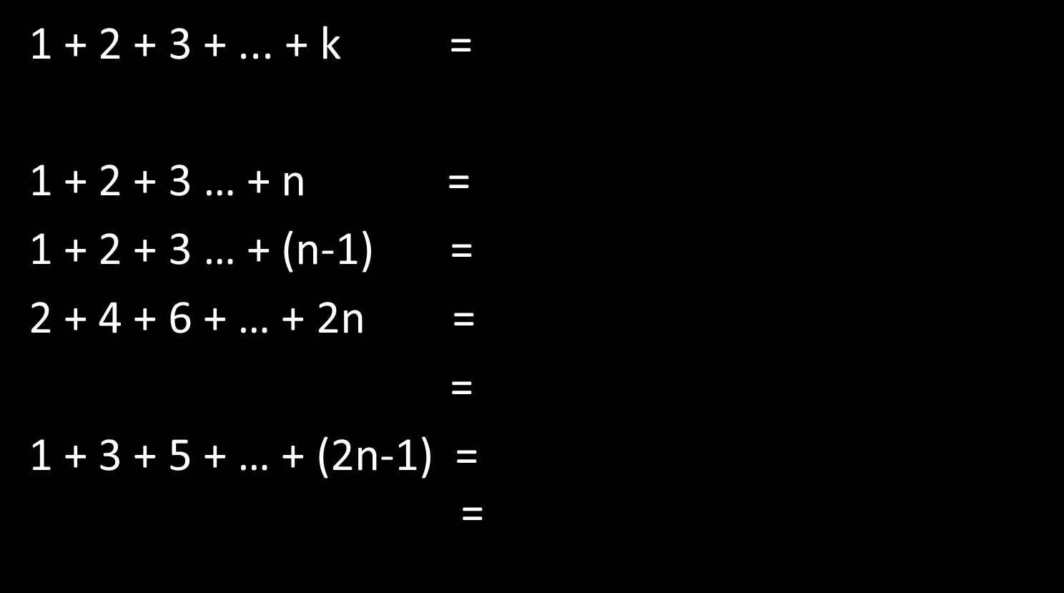
Simple Summations

Slide 3
Simplifying and Summing
Operation | Count | Operation | Count
int i = 0 | 1 | j < data.length | 1 + 2 + 3 + … + n
i < data.length | n+1 | j++ | 0 + 1 + 2 + … + (n-1)
i++ | n | data[j] < data[smallest] | 0 + 1 + 2 + … + (n-1)
int smallest = i | n | smallest = j | 0 + 1 + 2 + … + (n-1)
int j = i+1 | n | swap(data, smallest, j) | n
Operation | Count | Operation | Count
int i = 0 | 1 | j < data.length | n(n+1)/2
i < data.length | n+1 | j++ | 0 + 1 + 2 + … + (n-1)
i++ | n | data[j] < data[smallest] | 0 + 1 + 2 + … + (n-1)
int smallest = i | n | smallest = j | 0 + 1 + 2 + … + (n-1)
int j = i+1 | n | swap(data, smallest, j) | n
Operation | Count | Operation | Count
int i = 0 | 1 | j < data.length | n(n+1)/2
i < data.length | n+1 | j++ | n(n-1)/2
i++ | n | data[j] < data[smallest] | 0 + 1 + 2 + … + (n-1)
int smallest = i | n | smallest = j | 0 + 1 + 2 + … + (n-1)
int j = i+1 | n | swap(data, smallest, j) | n
Operation | Count | Operation | Count
int i = 0 | 1 | j < data.length | n(n+1)/2
i < data.length | n+1 | j++ | n(n-1)/2
i++ | n | data[j] < data[smallest] | n(n-1)/2
int smallest = i | n | smallest = j | 0 + 1 + 2 + … + (n-1)
int j = i+1 | n | swap(data, smallest, j) | n
Operation | Count | Operation | Count
int i = 0 | 1 | j < data.length | n(n+1)/2
i < data.length | n+1 | j++ | n(n-1)/2
i++ | n | data[j] < data[smallest] | n(n-1)/2
int smallest = i | n | smallest = j | n(n-1)/2
int j = i+1 | n | swap(data, smallest, j) | n
Time (sec) | Count | Time (sec) | Count
a | 1 | f | n(n+1)/2
b | n+1 | g | n(n-1)/2
c | n | h | n(n-1)/2
d | n | i | n(n-1)/2
e | n | j | n
Time
= a + b(n+1) + cn + dn + en + fn(n+1)/2 + gn(n-1)/2 + hn(n-1)/2 + in(n-1)/2 + jn
= (f/2 + g/2 + h/2 + i/2) n² + (b + c + d + e + f/2 - g/2 - h/2 - i/2 + j) n + (a+b)
= c₁n² + c₂n + c₃

Slide 4
Doubling Behavior
To analyze an algorithm, it appears we need to
Count the operations and
Time the operations to obtain a formula of the form
Running time = c₁n² + c₂n + c₃
Fortunately, if all we care about is “doubling behavior”
The constants don’t matter.
There’s no need to time the operations to determine the constants.
Running time grows as n² + n + 1
Furthermore, if all we care about is “doubling behavior”
The low-order terms don’t matter.
We need only count operations carefully enough to determine the high-order term
Running time grows as n²

Slide 5
Asymptotic Complexity (Informally)
When we say that a function f(n) is O(n²), we are saying that:
Its high-order term is no bigger than an n² term
Asymptotically, (in the limit, as n goes to infinity):
f(2n) is no more than 4 times f(n)
f(n)’s rate of growth ≤ n²’s rate of growth
n²’s rate of growth is an upper bound on f(n)’s rate of growth
When we say that a function f(n) is Ω(n²), we are saying that:
Its high-order term is no smaller than an n² term
Asymptotically:
f(2n) is no less than 4 times f(n)
f(n)’s rate of growth ≥ n²’s rate of growth
n²’s rate of growth is a lower bound on f(n)’s rate of growth
When we say that a function f(n) is Θ(n²), we are saying that
Its high-order term is an n² term
Asymptotically:
f(2n) is 4 times f(n)
f(n)’s rate of growth = n²’s rate of growth
n²’s rate of growth is an upper and lower bound on f(n)’s rate of growth

Slide 6
Examples
3n² + 5n + 3
is O(n³) O(n² log n) O(n²)
is not O(n log n) O(n) O(1)
is Ω(1) Ω(n) Ω(n log n) Ω(n²)
is not Ω(n² log n) Ω(n³)
is Θ(n²)
is not Θ(1) Θ(n) Θ(n log n) Θ(n² log n) Θ(n³)
is o(n³) o(n² log n)
is not o(n²) o(n log n) o(n) o(1)
is ω(1) ω(n) ω(n log n)
is not ω(n²) ω(n² log n) ω(n³)

Slide 7
Complexity Notation
Symbol | Say that f(n) is ___ of g(n) | Asymptotic rate of growth of f(n) __ g(n) | Equivalent to
f(n) is O(g(n)) | oh (or big oh) | ≤ | g(n) is Ω(f(n))
Symbol | Say that f(n) is ___ of g(n) | Asymptotic rate of growth of f(n) __ g(n) | Equivalent to
f(n) is O(g(n)) | oh (or big oh) | ≤ | g(n) is Ω(f(n))
f(n) is Ω(g(n)) | omega (or big omega) | ≥ | g(n) is O(f(n))
Symbol | Say that f(n) is ___ of g(n) | Asymptotic rate of growth of f(n) __ g(n) | Equivalent to
f(n) is O(g(n)) | oh (or big oh) | ≤ | g(n) is Ω(f(n))
f(n) is Θ(g(n)) | theta | = | f(n) is O(g(n)) & f(n) is Ω(g(n))
f(n) is Ω(g(n)) | omega (or big omega) | ≥ | g(n) is O(f(n))
Symbol | Say that f(n) is ___ of g(n) | Asymptotic rate of growth of f(n) __ g(n) | Equivalent to
f(n) is o(g(n)) | little oh | < | g(n) is ω (f(n))
f(n) is O(g(n)) | oh (or big oh) | ≤ | g(n) is Ω(f(n))
f(n) is Θ(g(n)) | theta | = | f(n) is O(g(n)) & f(n) is Ω(g(n))
f(n) is Ω(g(n)) | omega (or big omega) | ≥ | g(n) is O(f(n))
Symbol | Say that f(n) is ___ of g(n) | Asymptotic rate of growth of f(n) __ g(n) | Equivalent to
f(n) is o(g(n)) | little oh | < | g(n) is ω (f(n))
f(n) is O(g(n)) | oh (or big oh) | ≤ | g(n) is Ω(f(n))
f(n) is Θ(g(n)) | theta | = | f(n) is O(g(n)) & f(n) is Ω(g(n))
f(n) is Ω(g(n)) | omega (or big omega) | ≥ | g(n) is O(f(n))
f(n) is ω(g(n)) | little omega | > | g(n) is o(f(n))

Slide 8
Using Complexity Notation 1
void SelectionSort (int[] data) for (int i = 0; i < data.length; i++)
int smallest = i;
for (int j = i+1; j < data.length; j++)
if (data[j] < data[smallest]) smallest = j;
swap(data, smallest, i)
We can say
Selection sort is o(n³), Θ(n²), and ω(n)
Selection sort is O(n²) and Ω(n²) (and the bounds are tight)
Selection sort is O(n³) and Ω(n) (but the bounds are not tight)
Selection sort is NEITHER o(n²) NOR ω(n²)
The worst case of selection sort is Ω(n²)
The best case of selection sort is O(n²)
Note
O() and Ω() bounds are not necessarily tight
O() does not mean “worst case.” It means “upper bound.”
Ω() does not mean “best case.” It means “lower bound.”

Slide 9
Using Complexity Notation 2
void InsertionSort (int[] data) for (int i = 1; i < data.length; i++)
int j = i
while (j > 0 && data[j] > data[j-1])
data[j] = data[j-1]
j--
data[j-1] = data[i]
At best, there are n-1 = Θ(n) data comparisons
At worst, there are 1 + 2 + … + n-1 = Θ(n²) data comparisons
We can say
Insertion sort is O(n²) and Ω(n) (and the bounds are tight)
We can’t put a Θ() bound on insertion sort
However, we can say that the worst case is Θ(n²) and the best case is Θ(n)

Slide 10
Using Complexity Notation 3
Complexity notation is also used to put bounds on classes of algorithms:
Sorting is Ω(n)
The worst case of every sorting algorithm is Ω(n)
(Actually, linear time is required in all cases!)
Comparison-based sorting is Ω(n log n)
The worst case of every comparison-based sorting algorithm is Ω(n log n)
(Actually, some cases can be faster, but not all of them.)
Comparison-based sorting is O(n log n)
There is an O(n log n) algorithm for comparison-based sorting
(For example, mergesort)
So, when we say that some problem is Ω(g(n)), we are saying that every algorithm for that problem has a worst case that is Ω(g(n)).
When we say that some problem is O(f(n)), we are saying that some algorithm for that problem has a worst case that is O(f(n)).

Slide 11
Domination
If f(n) is o(g(n)), we say that g(n) “dominates” f(n)
In descending order of domination:
Name | Notation | Restriction | Note
Factorial | n!
Exponential | a^{n} | a > 1 | If a > b then a^{n} dominates b^{n}
Polynomial | nª | a > 0 | If a > b then nª dominates n^{b}
Logarithmic | (log n)ª | a > 0 | If a > b then (log n)ª dominates (log n)^{b}
Constant | 1
See rate of growth spreadsheet

Slide 12
Simplifying
Rule | Think
c g(n) is Θ(g(n)) | Ignore leading constants
If f(n) is o(g(n)), then g(n) + f(n) is Θ(g(n)) | Ignore low-order terms
If f₁(n) is o(g₁(n)) and f₂(n) is O(g₂(n)), then f₁(n) f₂(n) is o(g₁(n) g₂(n)) | Compare products
To simplify complexity expression f₁(n) into f₂(n)
Express f₁(n) as a sum of terms
Remove the low-order (dominated) terms
Remove the leading constants
f₁(n) is Θ(f₂(n))

Slide 13
Simplification Examples
3n² + 5n – 3 is Θ(n²)
[ Remove low-order terms and leading constant ]
n is o(n log(n))
[ 1 is o(log(n)) and n is O(n) ]
n log(n) is o(n²)
[ log(n) is o(n) and n is O(n) ]
100 2^{n} is o(n2^{n})
[ 100 is o(n) and 2^{n} is O(2^{n}) ]

Slide 14
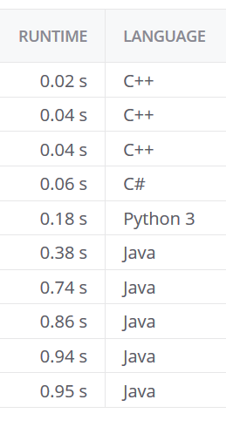
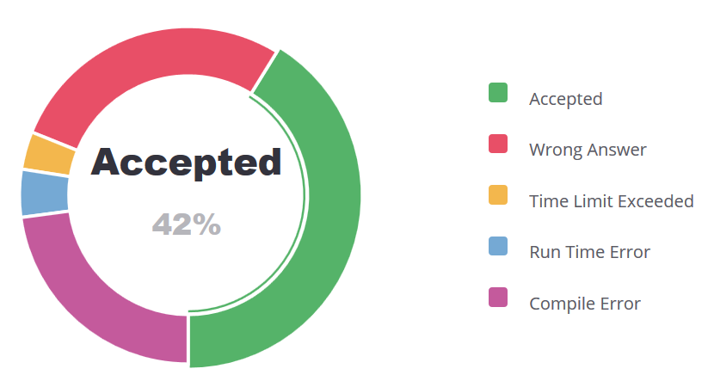
Planting Trees on Kattis

Slide 15
Asymptotic Complexity (Exactly)
Book Definition:
Let f(n) and g(n) be functions from positive integers to positive reals. We say that
f(n) is O(g(n))
if there is a constant c > 0 such that f(n) ≤ c g(n).
More Traditional Definition:
Let f(n) and g(n) be functions from reals to reals. We say that
f(n) is O(g(n))
if there are positive constants c and n₀ such that 0 ≤ f(n) ≤ c g(n) for all n ≥ n₀
The two definitions are
equivalent on functions from positive integers to positive reals, but
the traditional definition is more general and is easier to use in some proofs
so we’ll go with the traditional definition.

Slide 16
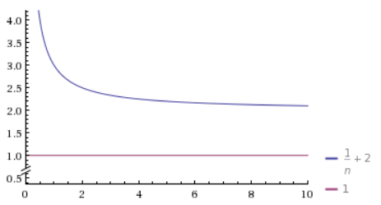
Asymptotic Complexity
f(n) = 1/n + 2
g(n) = 1
f(n) is O(g(n)) g(n) is O(f(n)) ??

Slide 17
Complexity Notation
Symbol | Say that f(n) is ___ of g(n) | Asymptotic rate of growth of f(n) __ g(n) | Equivalent to
f(n) is O(g(n)) | oh (or big oh) | ≤ | g(n) is Ω(f(n))
Symbol | Say that f(n) is ___ of g(n) | Asymptotic rate of growth of f(n) __ g(n) | Equivalent to
f(n) is O(g(n)) | oh (or big oh) | ≤ | g(n) is Ω(f(n))
f(n) is Ω(g(n)) | omega (or big omega) | ≥ | g(n) is O(f(n))
Symbol | Say that f(n) is ___ of g(n) | Asymptotic rate of growth of f(n) __ g(n) | Equivalent to
f(n) is O(g(n)) | oh (or big oh) | ≤ | g(n) is Ω(f(n))
f(n) is Θ(g(n)) | theta | = | f(n) is O(g(n)) & f(n) is Ω(g(n))
f(n) is Ω(g(n)) | omega (or big omega) | ≥ | g(n) is O(f(n))
Symbol | Say that f(n) is ___ of g(n) | Asymptotic rate of growth of f(n) __ g(n) | Equivalent to
f(n) is o(g(n)) | little oh | < | g(n) is ω (f(n))
f(n) is O(g(n)) | oh (or big oh) | ≤ | g(n) is Ω(f(n))
f(n) is Θ(g(n)) | theta | = | f(n) is O(g(n)) & f(n) is Ω(g(n))
f(n) is Ω(g(n)) | omega (or big omega) | ≥ | g(n) is O(f(n))
Symbol | Say that f(n) is ___ of g(n) | Asymptotic rate of growth of f(n) __ g(n) | Equivalent to
f(n) is o(g(n)) | little oh | < | g(n) is ω (f(n))
f(n) is O(g(n)) | oh (or big oh) | ≤ | g(n) is Ω(f(n))
f(n) is Θ(g(n)) | theta | = | f(n) is O(g(n)) & f(n) is Ω(g(n))
f(n) is Ω(g(n)) | omega (or big omega) | ≥ | g(n) is O(f(n))
f(n) is ω(g(n)) | little omega | > | g(n) is o(f(n))
Let f(n) and g(n) be functions from reals to reals. We say that
f(n) is o(g(n)): For any c > 0 there is an n₀ > 0 such that 0 ≤ f(n) ≤ cg(n) for all n ≥ n₀
f(n) is O(g(n)): There are c > 0 and n₀ > 0 such that 0 ≤ f(n) ≤ cg(n) for all n ≥ n₀
f(n) is Θ(g(n)): f(n) is O(g(n)) and f(n) is Ω(g(n))
f(n) is Ω(g(n)): There are c > 0 and n₀ > 0 such that 0 ≤ cg(n) ≤ f(n) for all n ≥ n₀
f(n) is ω(g(n)): For any c > 0 there is an n₀ > 0 such that 0 ≤ cg(n) ≤ f(n) for all n ≥ n₀

Slide 18
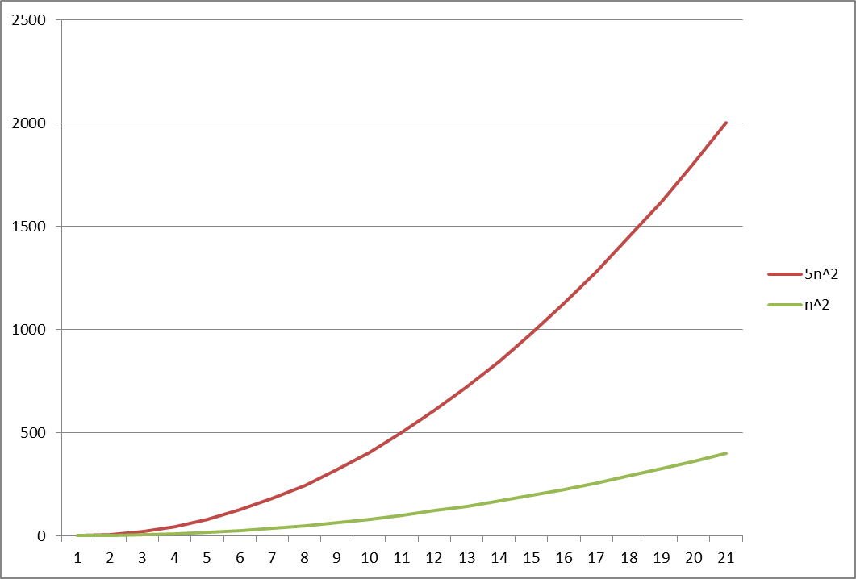
Proof 1
Prove: 5n² is O(n²)
Proof: We need to find c and n₀ such that 0 ≤ 5n² ≤ cn² for all n ≥ n₀ If n₀ > 0, this simplifies to 0 ≤ 5 ≤ c for all n ≥ n₀
Thus c = 5 (or anything larger) and n₀ = 1 (or any positive number) satisfy the original inequality

Slide 19
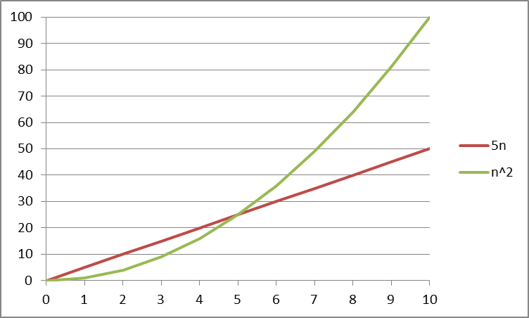
Proof 2
Prove: 5n is O(n²)
Proof: We need c and n₀ such that 0 ≤ 5n ≤ cn² whenever n ≥ n₀
If n₀ > 0, this simplifies to 0 ≤ 5/n ≤ c whenever n ≥ n₀
If n₀ ≥ 5, this simplifies to 0 ≤ 5/n ≤ 1 ≤ c whenever n ≥ n₀
Thus c = 1 and n₀ = 5 satisfy the original inequality

Slide 20
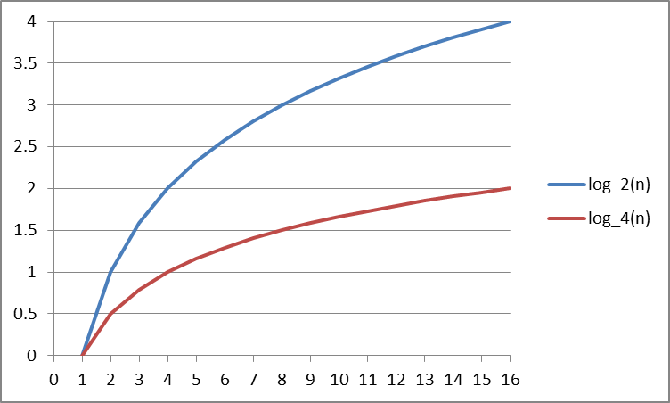
Proof 3
Prove: log₂(n) is O(log₄(n))
Proof: We need c and n₀ such that 0 ≤ log₂(n) ≤ c log₄(n) whenever n ≥ n₀
Here’s a handy identity: log_{a}(n) = log_{b}(n) / log_{b}(a)
By this identity, we need c and n₀ such that 0 ≤ log₂(n) ≤ c/2 log₂(n) whenever n ≥ n₀
If n > 1, this simplifies to 0 ≤ 1 ≤ c/2 whenever n ≥ n₀
Thus c = 2 and n₀ = 2 satisfy the original inequality

Slide 21
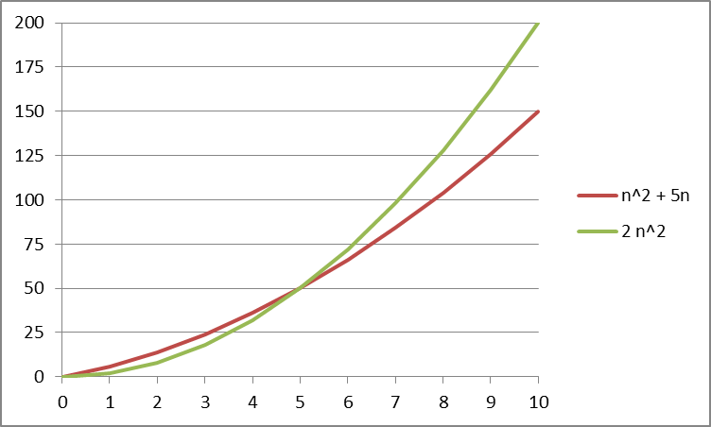
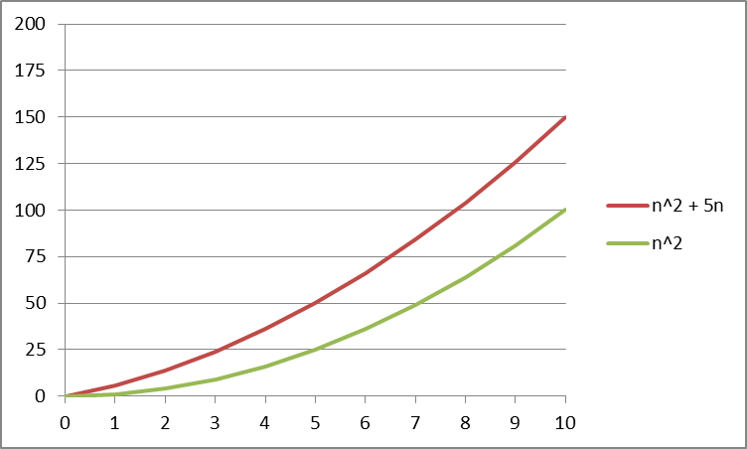
Proof 4
Prove: n² + 5n is O(n²)
Proof: We need c and n₀ such that 0 ≤ n² + 5n ≤ cn² whenever n ≥ n₀
If n₀ > 0, this simplifies to 0 ≤ 1 + 5/n ≤ c whenever n ≥ n₀
If n₀ ≥ 5, this simplifies to 0 ≤ 1 + 5/n ≤ 2 ≤ c whenever n ≥ n₀
Thus c = 2 and n₀ = 5 satisfy the original inequality

